Slide 1
Randomized Algorithms CS648
Lecture 14
Random sampling (last lecture)
Method of Bounded Difference

Slide 2
Recap of the previous lecture

Slide 3
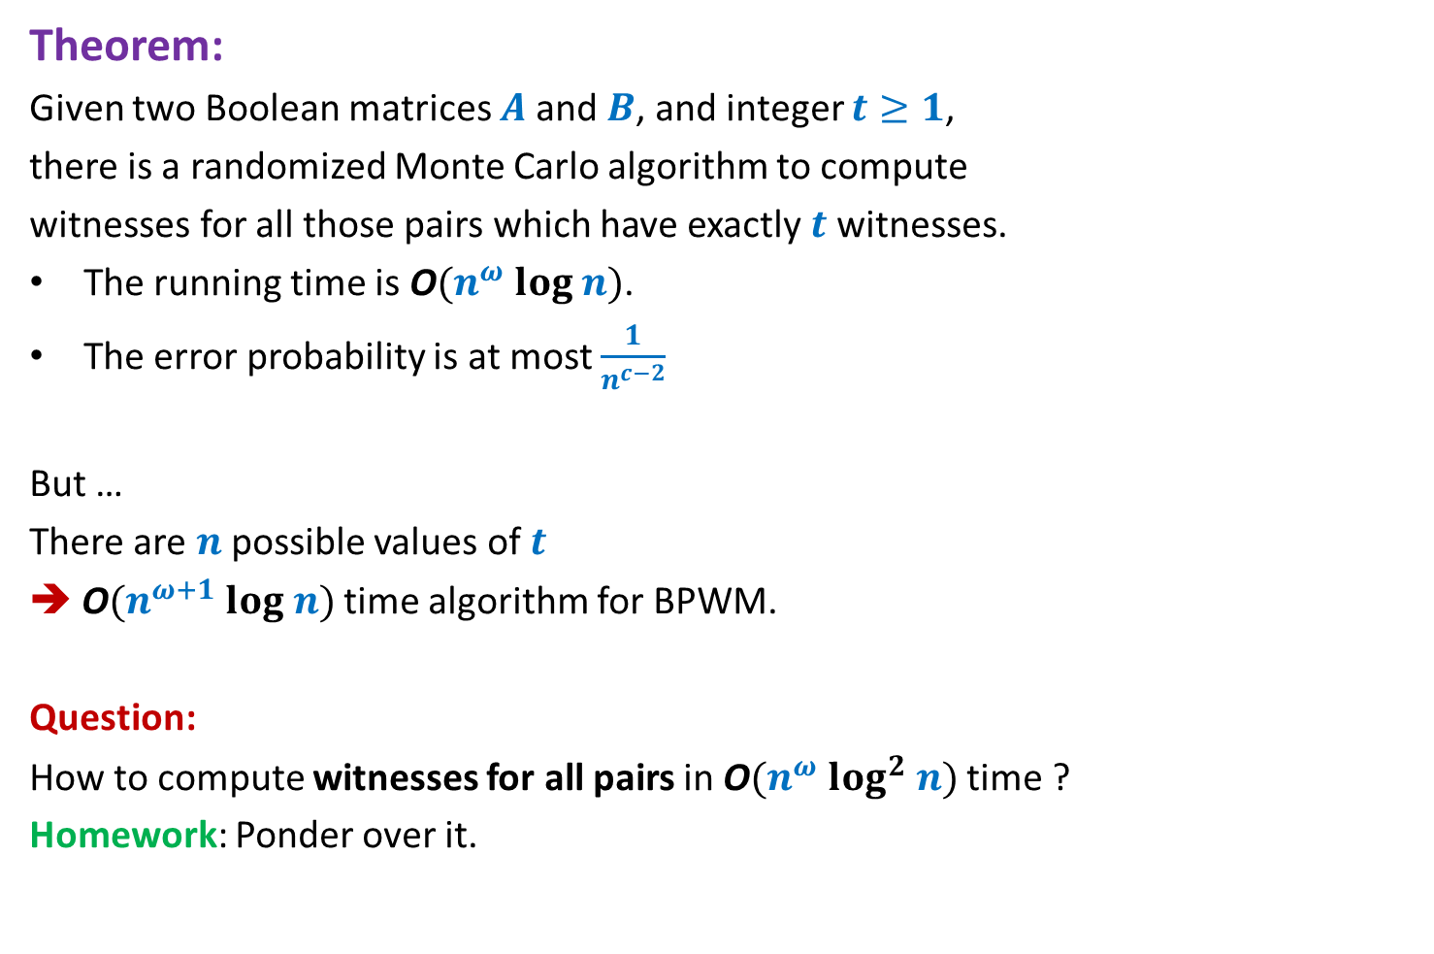
Algorithm for BPWM
Theorem:
Given two Boolean matrices $A$and $B$, and integer $t≥1$,
there is a randomized Monte Carlo algorithm to compute
witnesses for all those pairs which have exactly $t$ witnesses.
The running time is O$(n^{ω} log n)$.
The error probability is at most $\frac{1}{n^{c−2}}$
But …
There are $n$possible values of $t$
➔ O$(n^{ω+1} log n)$ time algorithm for BPWM.
Question:
How to compute witnesses for all pairs in O$(n^{ω} log^{2} n)$ time ?
Homework: Ponder over it.

Slide 4
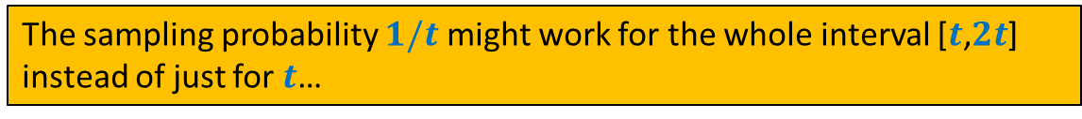






We seem to be too rigid in our approach
No. of witnesses | Sampling probability
$$t$$
$$1/t$$
$$t+1$$
$$1/(t+1)$$
…
…
$$2t$$
$$1/(2t)$$
The sampling probability $1/t$ might work for the whole interval [$t$,$2t$]
instead of just for $t$…

Slide 5
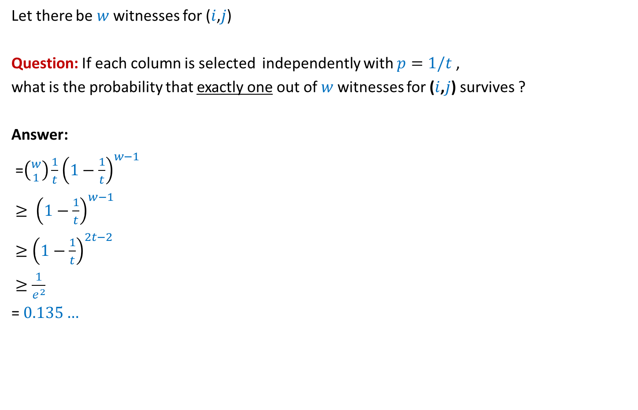
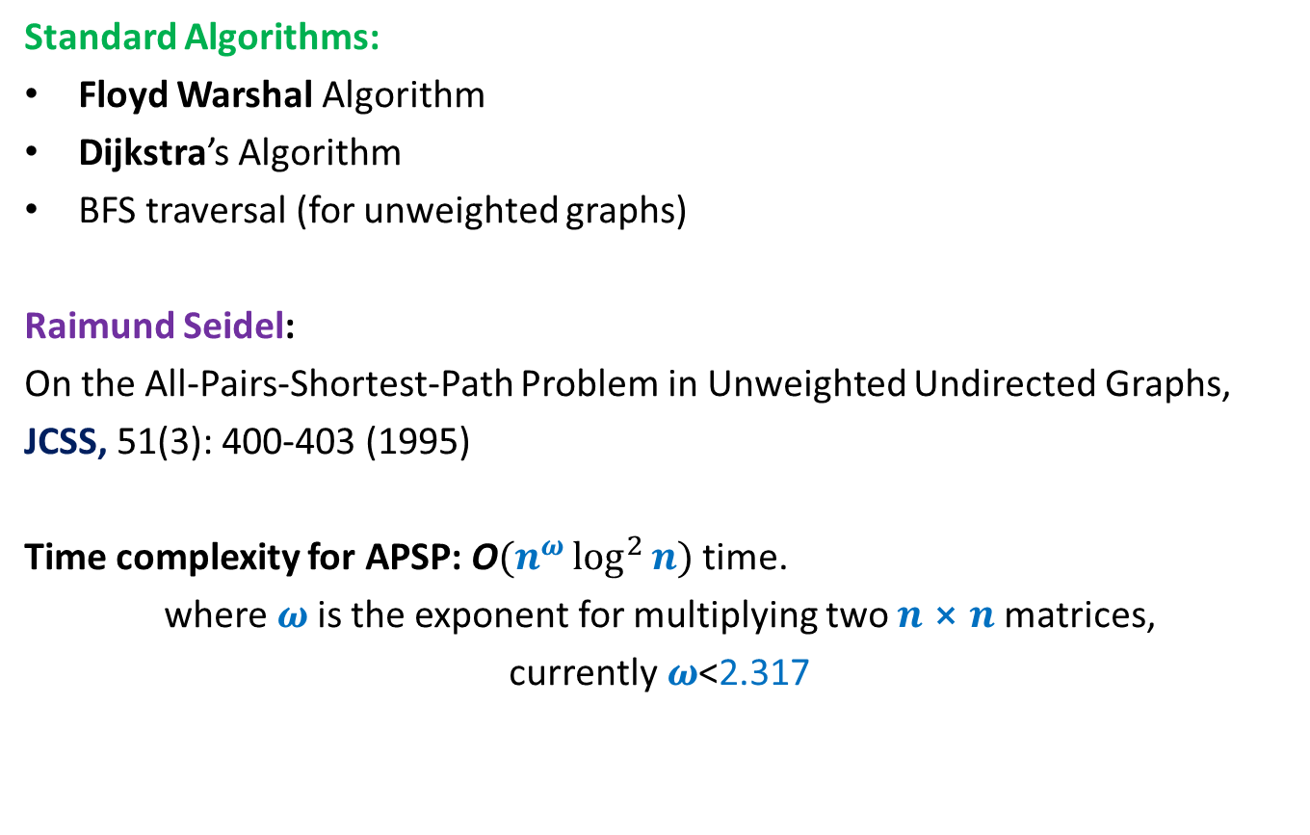
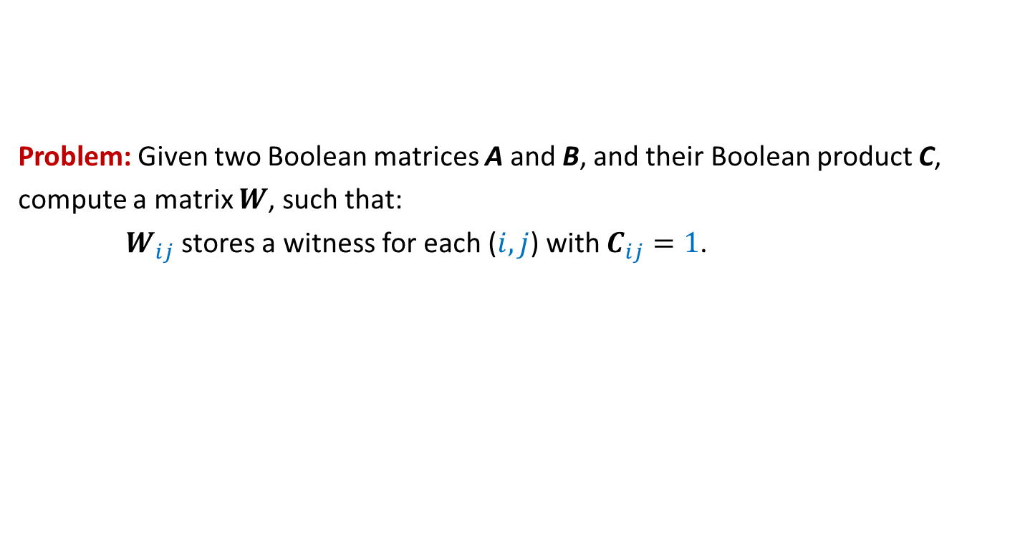
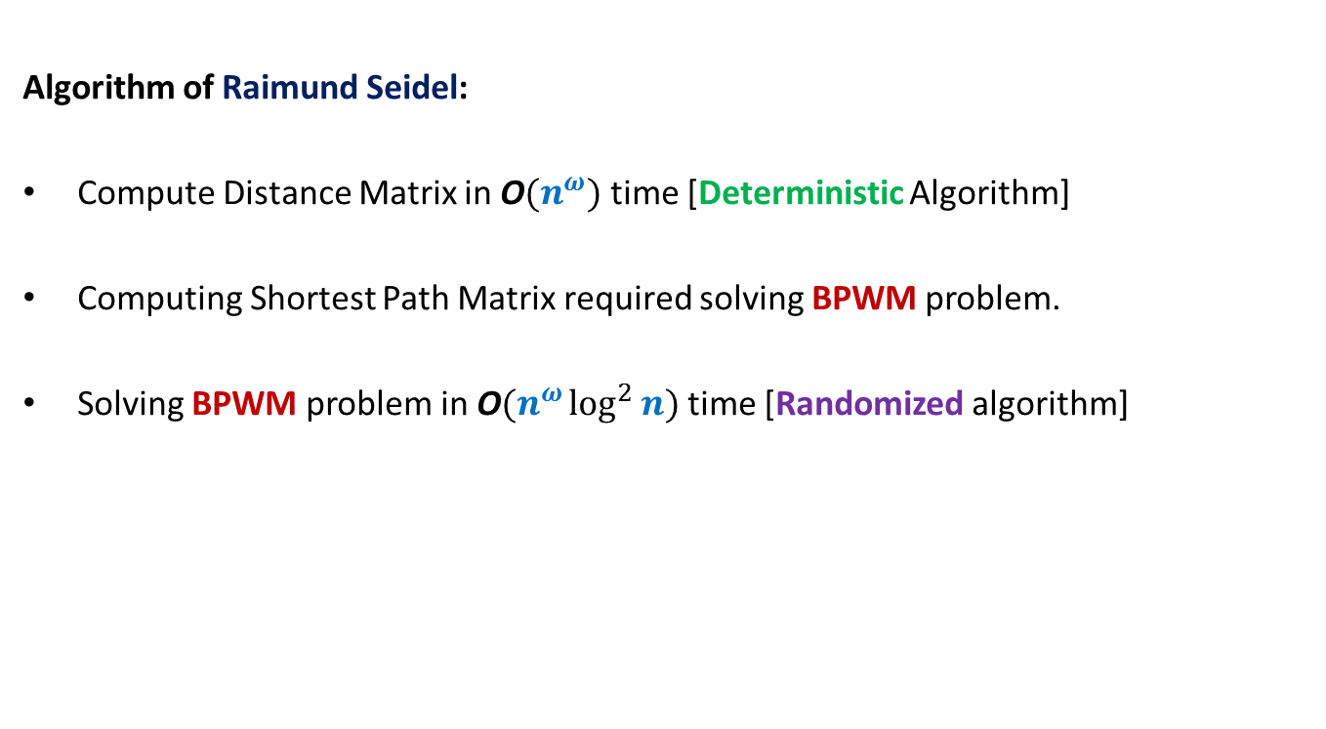
Focus on a single pair ($i$,$j$)
Let there be $w$ witnesses for ($i$,$j$)
Question: If each column is selected independently with $p=1/t$ ,
what is the probability that exactly one out of $w$witnesses for ($i$,$j$) survives ?
Answer:
=$\left({w \atop 1}\right)\frac{1}{t}{\left(1−\frac{1}{t}\right)}^{w−1}$
$≥ {\left(1−\frac{1}{t}\right)}^{w−1}$
$≥{\left(1−\frac{1}{t}\right)}^{2t−2}$
$≥\frac{1}{e^{2}}$
= $0.135…$
such that $t≤w<2t$
$$>\frac{1}{8}$$

Slide 6

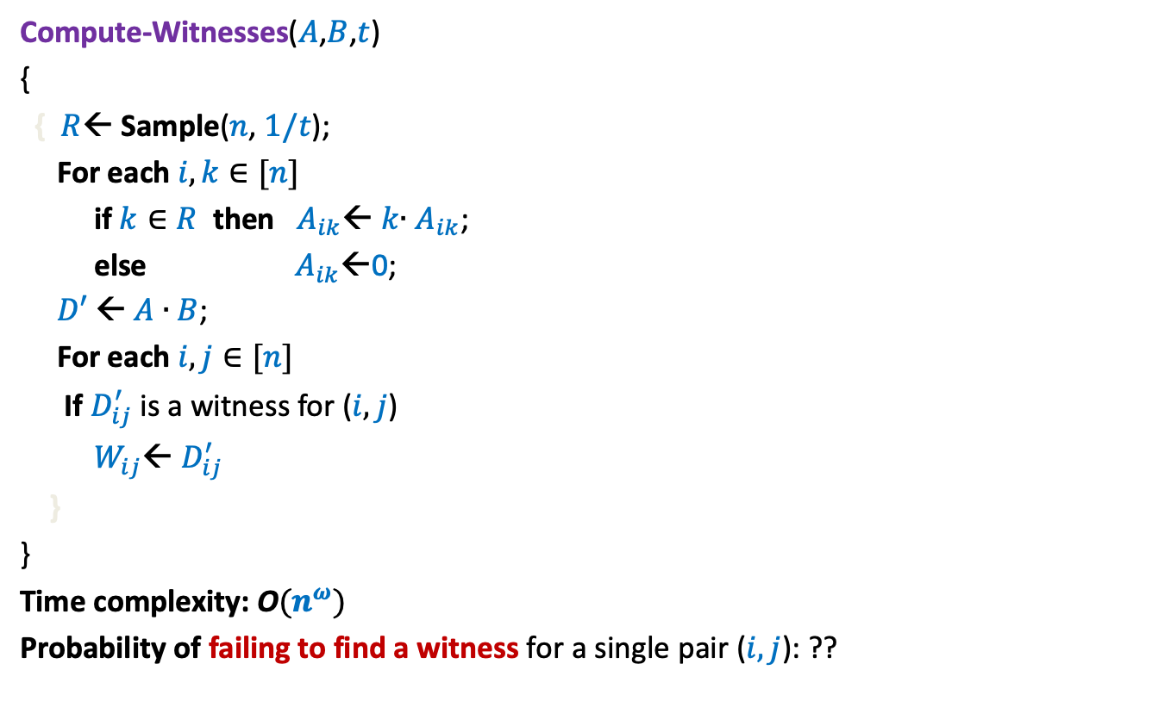

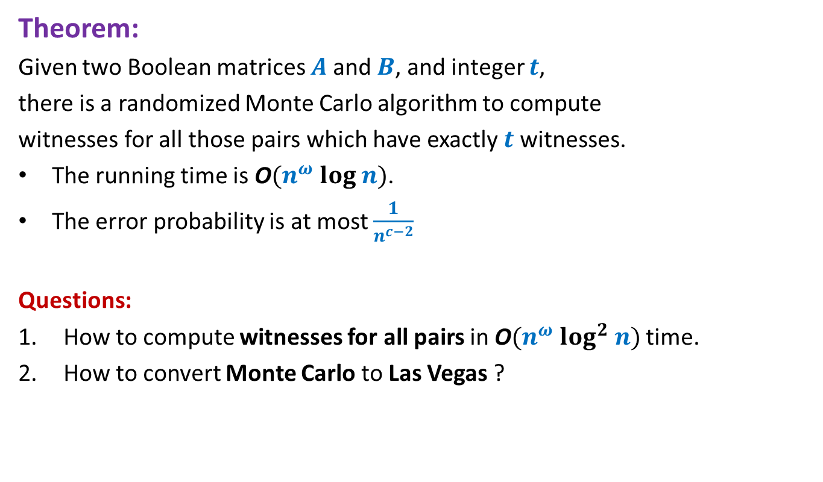

Randomized algorithm for Computing Witnesses for all pairs with witness count
$$∈[t,2t)$$
Compute-Witnesses($A$,$B$,$t$)
{
{ $R$← Sample($n$, $1/t$);
For each $i,k∈[n]$
if $k∈R$ then $A_{ik}$← $k$∙ $A_{ik}$;
else $A_{ik}$←0;
$D′$← $A$ ∙ $B$;
For each $i,j∈[n]$
If $D_{ij}^{′}$ is a witness for ($i,j$)
$W_{ij}$← $D_{ij}^{′}$
}
}
Time complexity: O$(n^{ω})$
Probability of failing to find a witness for a single pair ($i,j$): ??
How to reduce the error probability to $<\frac{1}{n^{c}}$ ?
Repeat the entire process ${c log}_{8/7} n$ times.
$$<1−\frac{1}{8}<\frac{7}{8}$$

Slide 7



Randomized algorithm for Computing Witnesses for all pairs with witness count
$$∈[t,2t)$$
Compute-Witnesses($A$,$B$,$t$)
{
{ $R$← Sample($n$, $1/t$);
For each $i,k∈[n]$
if $k∈R$ then $A_{ik}$← $k$∙ $A_{ik}$;
else $A_{ik}$←0;
$D′$← $A$ ∙ $B$;
For each $i,j∈[n]$
If $D_{ij}^{′}$ is a witness for ($i,j$)
$W_{ij}$← $D_{ij}^{′}$
}
}
Time complexity: O$(n^{ω})$
Probability of failing to find a witness for a single pair ($i,j$): ??
Repeat $c log_{8/7} n$times
{
}
$$\log{n})$$
$$<\frac{1}{n^{c}}$$

Slide 8
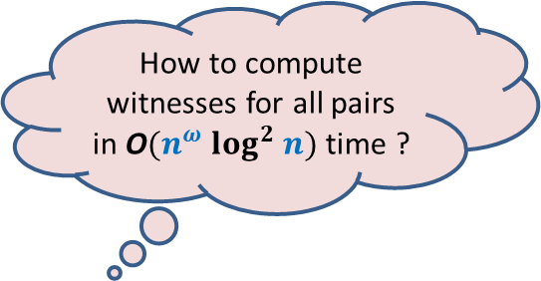
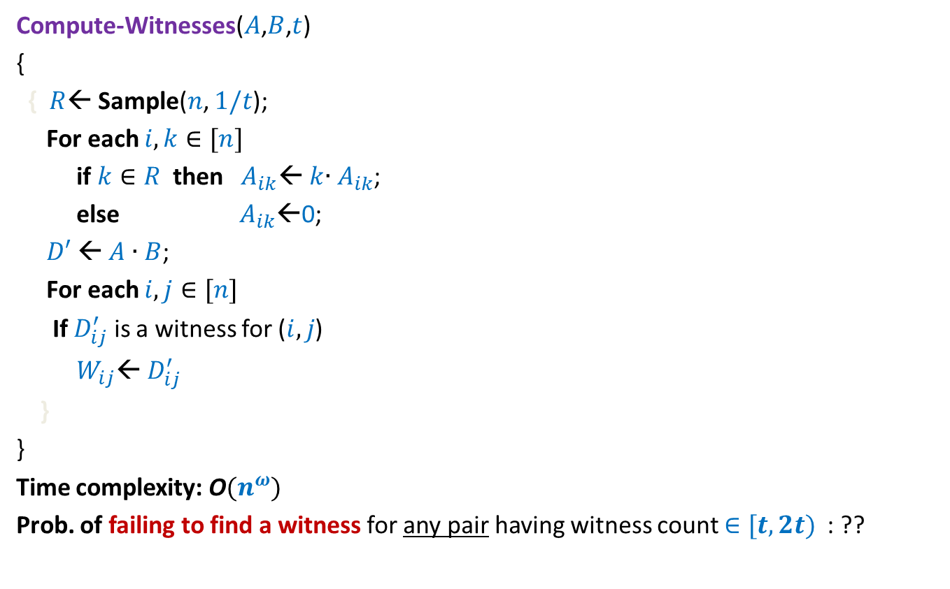

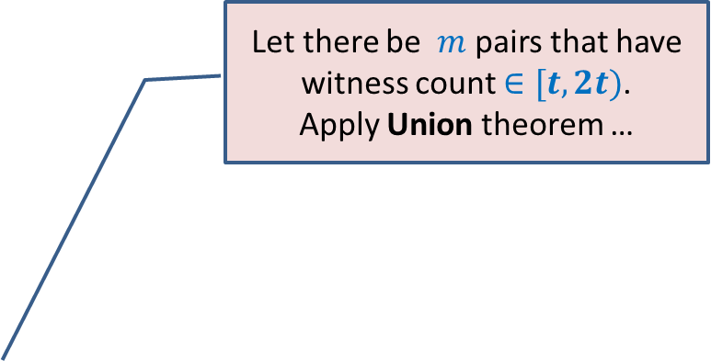
Randomized algorithm for Computing Witnesses for all pairs with witness count
$$∈[t,2t)$$
Compute-Witnesses($A$,$B$,$t$)
{
{ $R$← Sample($n$, $1/t$);
For each $i,k∈[n]$
if $k∈R$ then $A_{ik}$← $k$∙ $A_{ik}$;
else $A_{ik}$←0;
$D′$← $A$ ∙ $B$;
For each $i,j∈[n]$
If $D_{ij}^{′}$ is a witness for ($i,j$)
$W_{ij}$← $D_{ij}^{′}$
}
}
Time complexity: O$(n^{ω})$
Prob. of failing to find a witness for any pair having witness count $∈[t,2t)$ : ??
Repeat $c log_{8/7} n$times
How to compute witnesses for all pairs in O$(n^{ω} log^{2} n)$ time ?
{
Homework 1
Let there be $m$ pairs that have witness count $∈[t,2t)$.
Apply Union theorem …
}
$$\log{n})$$
$<\frac{m}{n^{c}}$ < $\frac{1}{n^{c−2}}$

Slide 9
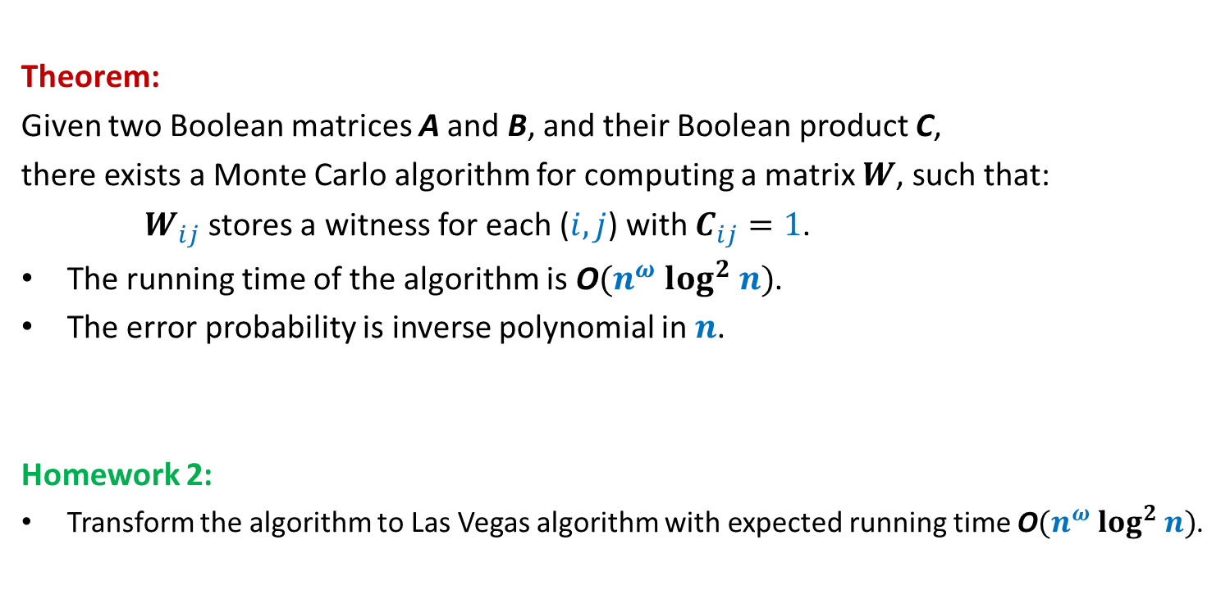
Boolean Product Witness Matrix (BPWM)
Theorem:
Given two Boolean matrices A and B, and their Boolean product C,
there exists a Monte Carlo algorithm for computing a matrix $W$, such that:
$W_{ij}$ stores a witness for each ($i,j$) with $C_{ij}=1$.
The running time of the algorithm is O$(n^{ω} log^{2} n)$.
The error probability is inverse polynomial in $n$.
Homework 2:
Transform the algorithm to Las Vegas algorithm with expected running time O$(n^{ω} log^{2} n)$.

Slide 10
Method of Bounded Difference

Slide 11

Objective
$x_{1},$ $x_{2}$,…, $x_{n}$: $n$ random variables, not necessarily independent
$f$ : function of $x_{1},$ $x_{2}$,…, $x_{n}$
How to establish a good bound on P[|$f−E[f]|>t$] ?

Slide 12
Tools discussed till now
Markov’s Inequality
Chebyshev’s Inequality
Chernoff bound

Slide 13
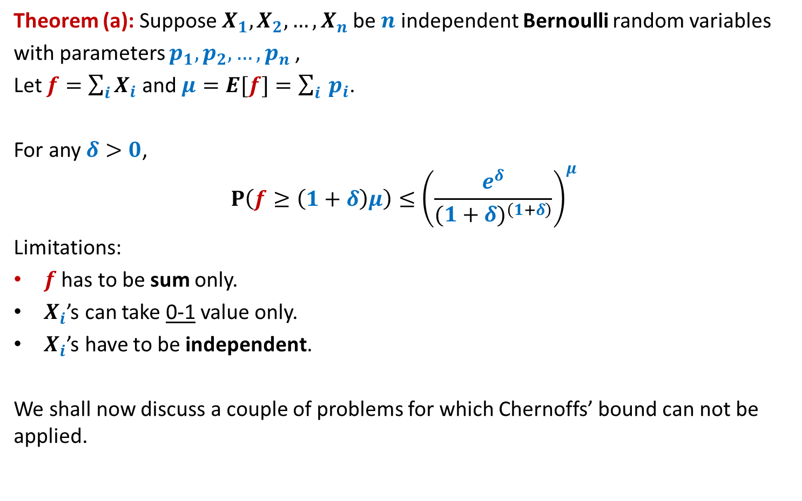
Chernoff’s Bound
Theorem (a): Suppose $X_{1},X_{2},…,X_{n}$be $n$ independent Bernoulli random variables
with parameters $p_{1},p_{2},…,p_{n}$,
Let $f=\sum_{i}{X_{i}}$ and $μ=E[f]=\sum_{i}{ p_{i}}$.
For any $δ>0$,
$$P\left(f≥\left(1+δ\right)μ\right)≤{\left(\frac{e^{δ}}{{(1+δ)}^{\left(1+δ\right)}}\right)}^{μ}$$
Limitations:
$f$ has to be sum only.
$X_{i}$’s can take 0-1 value only.
$X_{i}$’s have to be independent.
We shall now discuss a couple of problems for which Chernoffs’ bound can not be applied.

Slide 14

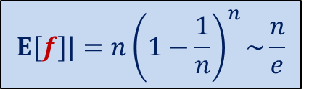

Balls into Bins
1 2 3 4 5 … $n−1 n$
$f$: number of empty bins.
: number of bins with $2$ balls.
1 2 3 … $i$ … $n$
$$E[f]|=n{\left(1−\frac{1}{n}\right)}^{n}\sim \frac{n}{e}$$
P[|$f−E[f]|>t$] = ?

Slide 15



Balls Out of Bin
There is a bin containing $n$ red balls and $n$ blue balls.
Balls are taken out from the bag
$f$: number of red balls in the first $n$ draws
uniformly randomly
and without replacement.
$$E[f]=\frac{n}{2}$$
P[|$f−E[f]|>t$] =?

Slide 16


The tightest analysis of Randomized Quick sort
Theorem [Colin McDiarmid, 1991]:
Prob. the run time of Randomized Quick sort exceeds average by $x\%$ = ?
$$n^{− \frac{x}{100} ln ln n}$$

Slide 17


Notations:
$X_{i}$: {$x_{1}$, $x_{2}$, …, $x_{i}$}
$A_{i}$: {$a_{1}$, $a_{2}$, …, $a_{i}$}
$X_{i}=A_{i}$ means
“$x_{1}=a_{1}\text{,}…,$ ${x_{i}=a}_{i}$”

Slide 18






A random experiment unfolding gradually
$$x_{1}$$
$$x_{1}=a_{1}$$
$$x_{2}$$
$$x_{2}=a_{2}$$
$$x_{3}$$
Quick sort
Balls out of Bin
Balls into Bin
…
$$Ω$$

Slide 19
Method of bounded difference

Slide 20











$$E[f]$$
$$x_{1}$$
$$E\left[f \right| x_{1}=a_{1}]$$
$$x_{1}=a_{1}$$
$$x_{2}$$
$$E\left[f \right| X_{2}=A_{2}]$$
$$x_{2}=a_{2}$$
$$E\left[f \right| x_{2}=a_{2},x_{1}=a_{1}]$$
…
$$E\left[f \right| X_{i−1}=A_{i−1}]$$
$$x_{i−1}=a_{i−1}$$
Balls out of Bin
Quick sort
Balls into Bin
$$x_{i}$$
$$E\left[f \right| X_{i−1}=A_{i−1} , x_{i}=a_{i}]$$
$$E\left[f \right| X_{i−1}=A_{i−1} , x_{i}=a_{i}′]$$
Difference < $c_{i}$
If $c_{i}$‘s are small, then probability that $f$ deviates significantly from $E[f]$
should be small.
Intuition:
$$Ω$$

Slide 21

Main theorem
Theorem:
Let $c_{1},c_{2},…,c_{n}$ be such that
for any $A_{i−1}∈X_{i−1}$, and any $a,a^{′}∈x_{i}$
$E\left[f \right| X_{i−1}=A_{i−1} , x_{i}=a]$ $−$ $E\left[f \right| X_{i−1}=A_{i−1} , x_{i}=a′]$ < $c_{i}$
Then
P[|$f−E\left[f\right]|>t$] < $2$exp$\left(−\frac{t^{2}}{2\sum_{i}{c_{i}^{2}}}\right)$

Slide 22


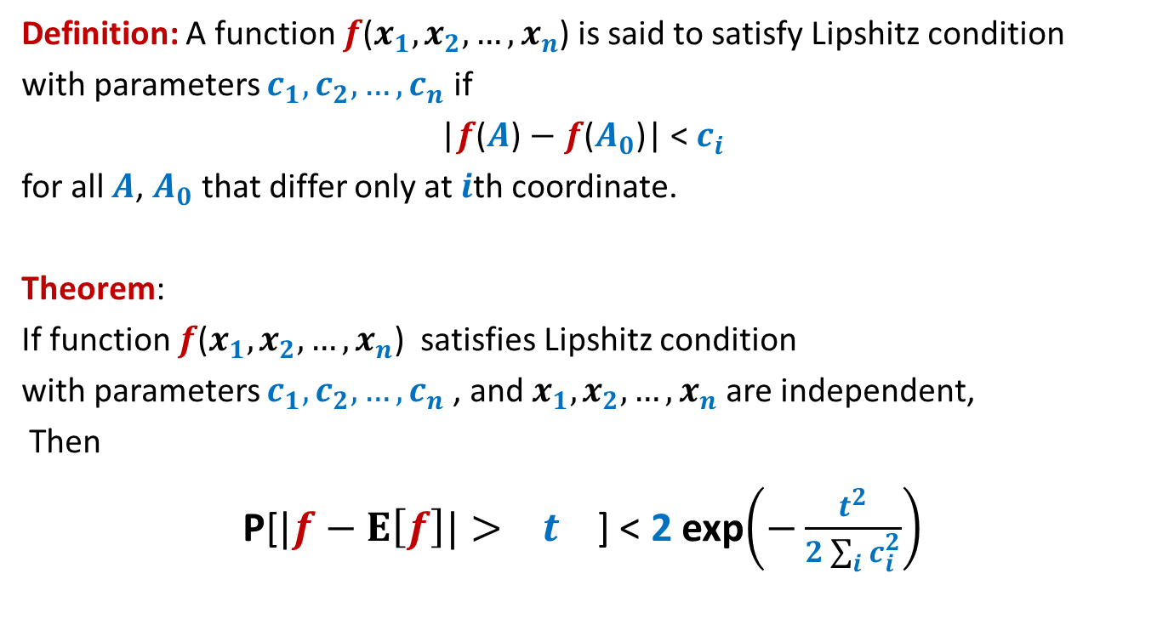


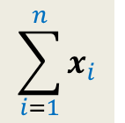

Special case theorem
Try comparing the deviation in heads in $n$ coin tosses with $t=εn$ using the above theorem and Chernoff bound.
Definition: A function $f$($x_{1},x_{2},…,x_{n}$) is said to satisfy Lipshitz condition
with parameters $c_{1},c_{2},…,c_{n}$ if
|$f$($A$) $−$ $f$($A_{0}$)| < $c_{i}$
for all $A$, $A_{0}$ that differ only at $i$th coordinate.
Theorem:
If function $f$($x_{1},x_{2},…,x_{n}$) satisfies Lipshitz condition
with parameters $c_{1},c_{2},…,c_{n}$, and $x_{1},x_{2},…,x_{n}$ are independent,
Then
P[$|f−E\left[f\right]|> t$] < 2 exp$\left(−\frac{t^{2}}{2\sum_{i}{c_{i}^{2}}}\right)$
$$E\left[f\right]$$
$x_{i}∈\{0,1\}$
2 exp$\left(−\frac{{\left(E\left[f\right]\right)}^{2}}{2n}\right)$
$$\sum_{i=1}^{n}{x_{i}}$$
$f$($x_{1},x_{2},…,x_{n}$) =
This theorem subsumes the Chernoff’s bound. ☺

Slide 23
Applications of
Method of bounded difference

Slide 24





Balls into Bins
1 2 3 4 5 … $n−1 n$
$f$: number of empty bins.
$x_{i}$ :
P[|$f−E\left[f\right]|>t$] < 2 exp$\left(−\frac{t^{2}}{2\sum_{i}{c_{i}^{2}}}\right)$
For $t=εn$
1 2 3 … $i$ … $n$
$1$ if $i$th bin is empty, and $0$ otherwise.
Label of the destination bin for $i$th ball.
$f$($x_{1},x_{2},…,x_{n}$) satisfies Lipshitz condition
with parameters $c_{i}=1$,
$\frac{ε^{2}}{2}n$

Slide 25




Balls Out of Bin
There is a bin containing $n$ red balls and $n$ blue balls.
Balls are taken out from the bag
$f$: number of red balls in the first $n$ draws
$x_{i}$ :
uniformly randomly
and without replacement.
First $n$ balls
First $i−1$ balls
Label of the ball picked at $i$th number.
$|E\left[f \right| X_{i−1}=A_{i−1} , x_{i}=a]$ $−$ $E\left[f \right| X_{i−1}=A_{i−1} , x_{i}=a′]|$ = ?

Slide 26

Balls Out of Bin
There is a bin containing $n$ red balls and $n$ blue balls.
Balls are taken out from the bag
$f$: number of red balls in the first $n$ draws
$x_{i}$ :
uniformly randomly
and without replacement.
First $n$ balls
First $i−1$ balls
Label of the ball picked at $i$th number.
$|E\left[f \right| X_{i−1}=A_{i−1} , x_{i}=a]$ $−$ $E\left[f \right| X_{i−1}=A_{i−1} , x_{i}=a′]|$ = ?
$$<1$$
Homework: Show it rigorously.

Slide 27
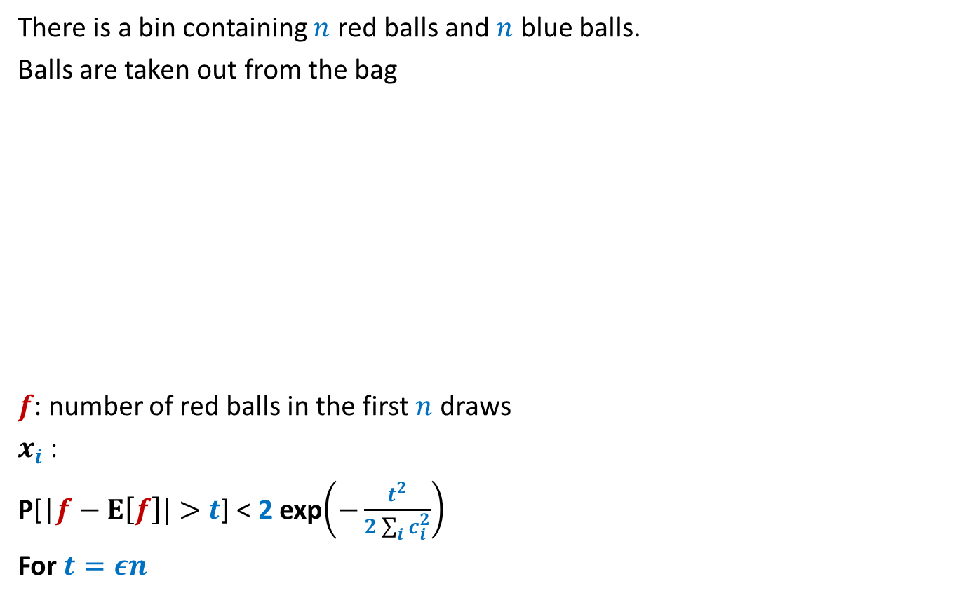

Balls Out of Bin
There is a bin containing $n$ red balls and $n$ blue balls.
Balls are taken out from the bag
$f$: number of red balls in the first $n$ draws
$x_{i}$ :
P[|$f−E\left[f\right]|>t$] < 2 exp$\left(−\frac{t^{2}}{2\sum_{i}{c_{i}^{2}}}\right)$
For $t=εn$
uniformly randomly
and without replacement.
First $i−1$ balls
Label of the ball picked at $i$th number.
$$\frac{ε^{2}}{2}n$$

Slide 28

Theme of this course

Slide 29







$n$ Counters
Each counter has a fair coin of its own.
0 0 0 0 0 0
$$1$$
$$2$$
$$i−1$$
$$i$$
$$i+1$$
$$n$$
H
T
T
H
T
T

Slide 30
$n$ Counters
Each counter has a fair coin of its own.
1 0 0 1 0 0
$$1$$
$$2$$
$$i−1$$
$$i$$
$$i+1$$
$$n$$
H
T
T
H
T
T

Slide 31

$n$ Counters
Each counter has a fair coin of its own.
Counter $C_{i}$ can increment in a round only if
the coin it tosses gives HEADS.
Neither $C_{i−1}$nor $C_{i+1}$ has value less than $C_{i}$.
What is the expected number of rounds till each counter becomes $n$ ?
1 0 0 2 0 0
$$1$$
$$2$$
$$i−1$$
$$i$$
$$i+1$$
$$n$$

Slide 32
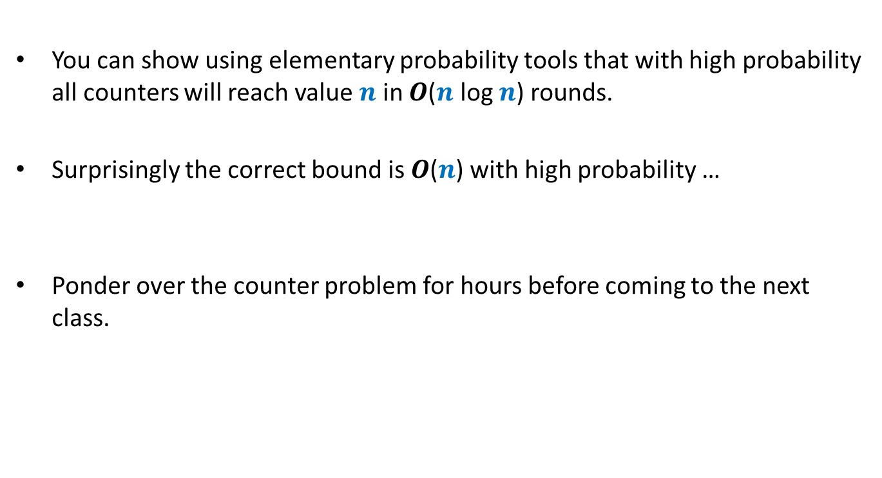
Homework 3
You can show using elementary probability tools that with high probability all counters will reach value $n$ in $O$($n$ log $n$) rounds.
Surprisingly the correct bound is $O$($n$) with high probability …
Ponder over the counter problem for hours before coming to the next class.

Slide 33

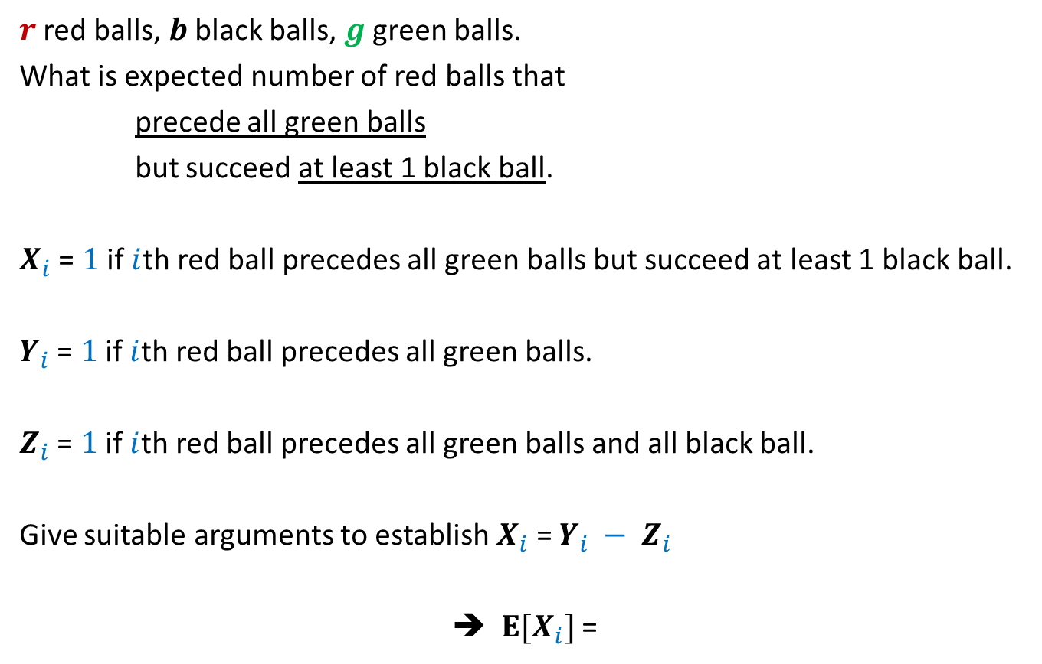
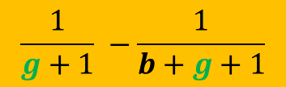
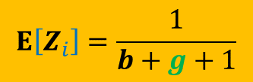
Mid semester exam
$r$ red balls, $b$ black balls, $g$ green balls.
What is expected number of red balls that
precede all green balls
but succeed at least 1 black ball.
$X_{i}$ = $1$ if $i$th red ball precedes all green balls but succeed at least 1 black ball.
$Y_{i}$ = $1$ if $i$th red ball precedes all green balls.
$Z_{i}$ = $1$ if $i$th red ball precedes all green balls and all black ball.
Give suitable arguments to establish $X_{i}$ = $Y_{i} − Z_{i}$
➔ $E[X_{i}]$ =
$$E\left[Y_{i}\right]=\frac{1}{g+1}$$
$$E\left[Z_{i}\right]=\frac{1}{b+g+1}$$
$$\frac{1}{g+1} −\frac{1}{b+g+1}$$

